Slide 1


PPT ON
“SALES FORECASTING SYSTEM”
FOR
“NEATLEAP IT TREANING AND SOLUTION”
Submitted by
Chetan Buva
Pranav Niphade
Siddharth Gangurde
MATOSHRI COLLAGE OF ENGINEERING AND REASERCH CENTER
Mentor Director And Founder
1.Chaitayna Dahale 1.Mrunal Dahale
2.Chaitayna Joshi
YEAR 2026

Slide 2
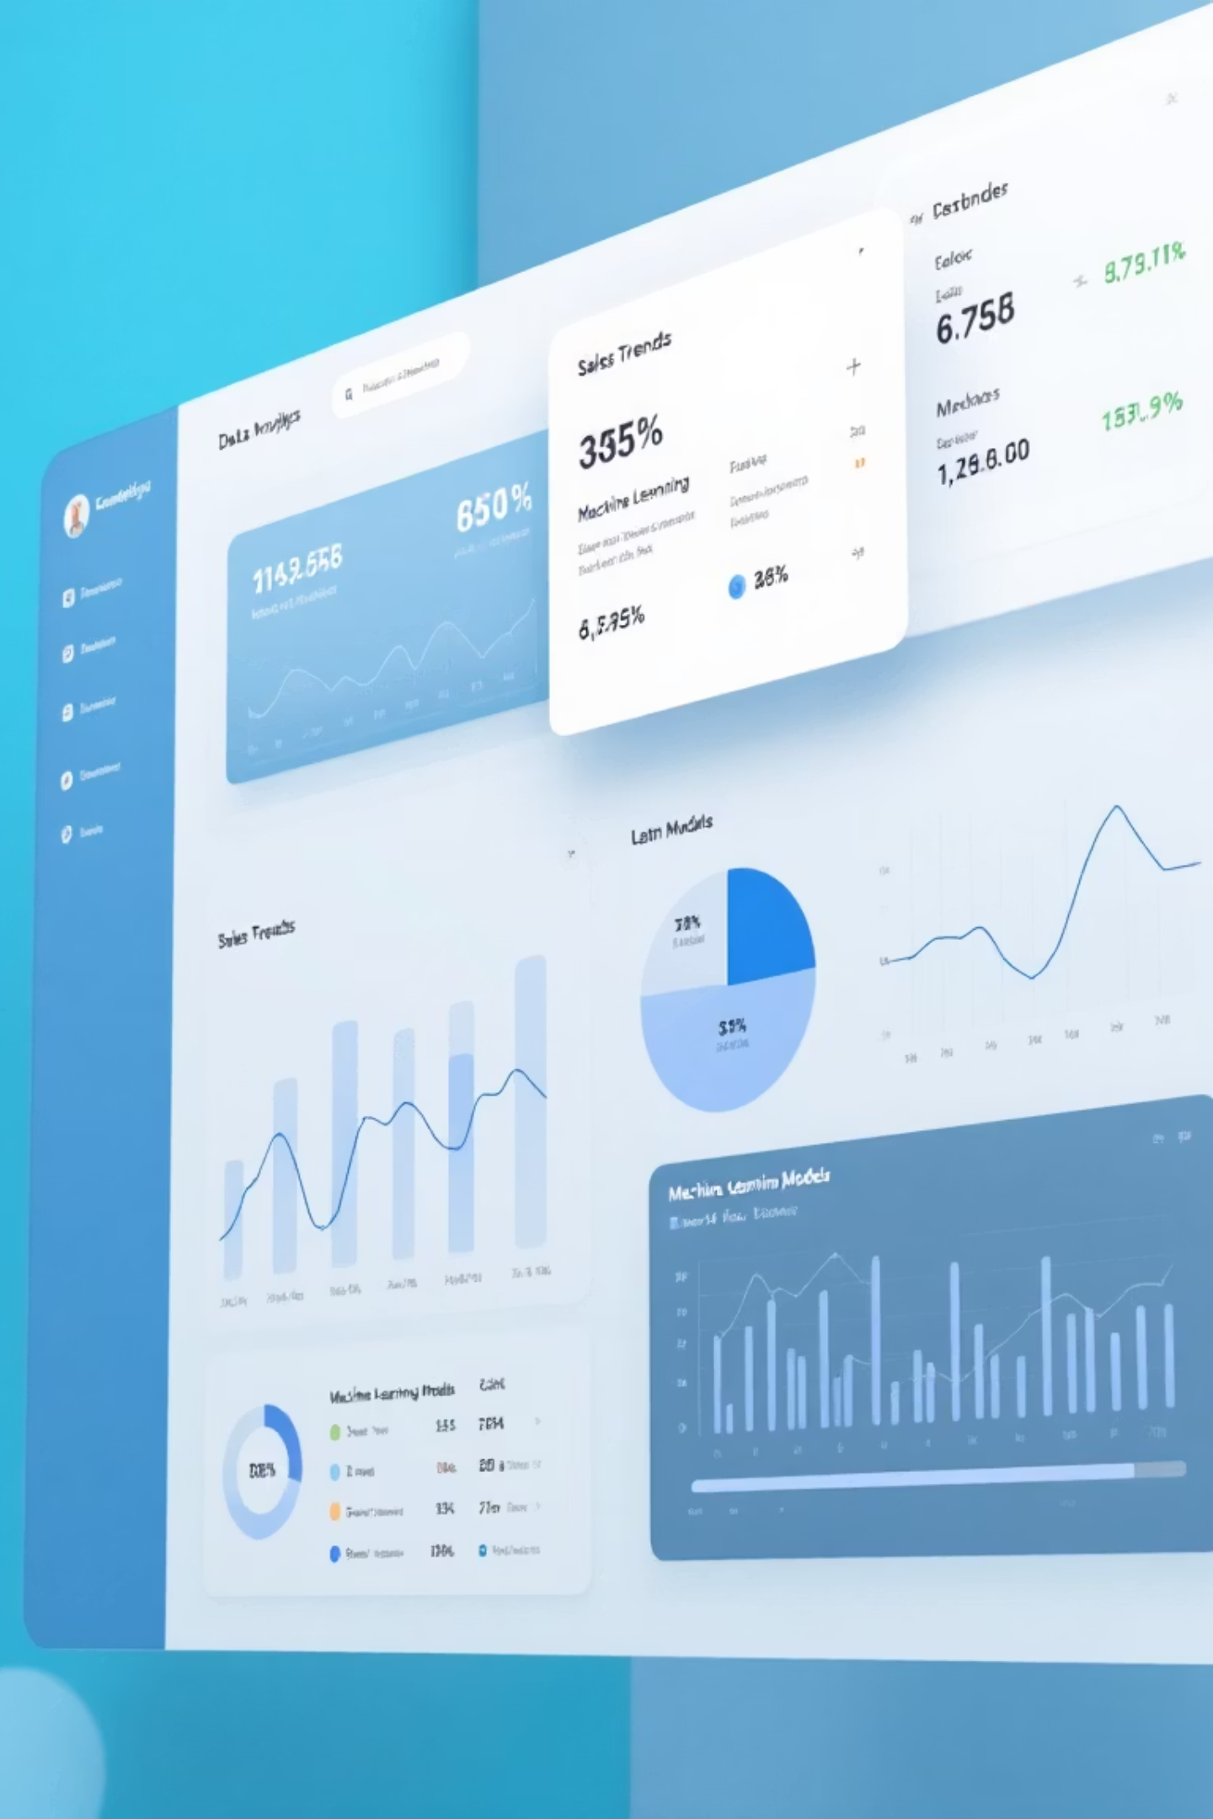
Wallmart Sales Forecasting System
A data-driven approach to predict future sales using historical data and machine learning models
Helping businesses improve planning, inventory management, and decision-making.

Slide 3
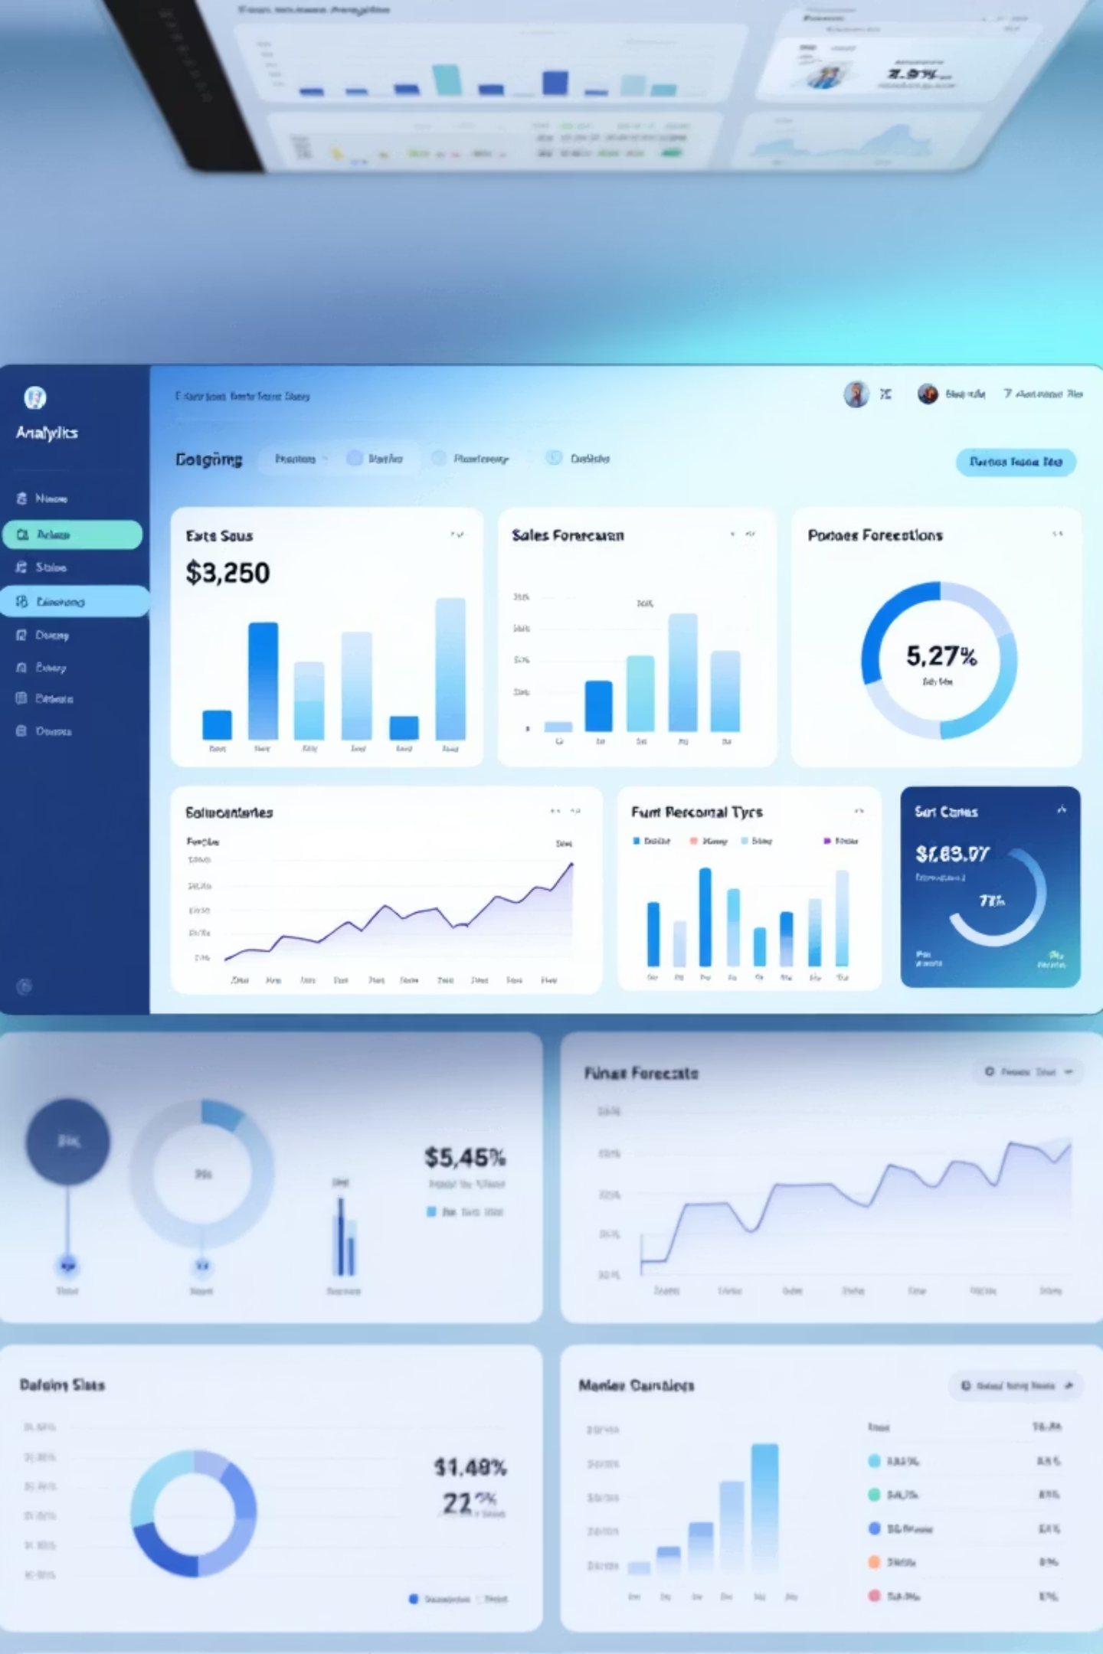
Why Sales Forecasting Matters
Sales forecasting plays a critical role in modern businesses
Accurate predictions help organizations reduce losses
Enables efficient inventory management
Helps respond to market trends
This project builds an intelligent system that analyzes historical sales data to predict future demand

Slide 4

Project Goals
Predict future sales with high accuracy
Analyze historical sales trends and patterns
Assist businesses in data-driven decision making
Visualize predictions using interactive dashboards

Slide 5
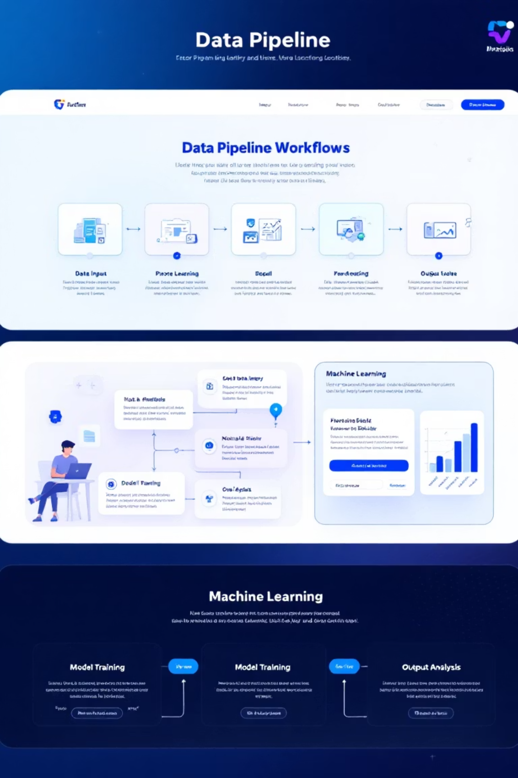
Project Pipeline
01
Data collection from historical sales records
02
Data cleaning and preprocessing
03
Feature engineering and transformation
04
Model training using machine learning algorithms
05
Model evaluation and selection
06
Sales forecasting and visualization

Slide 6
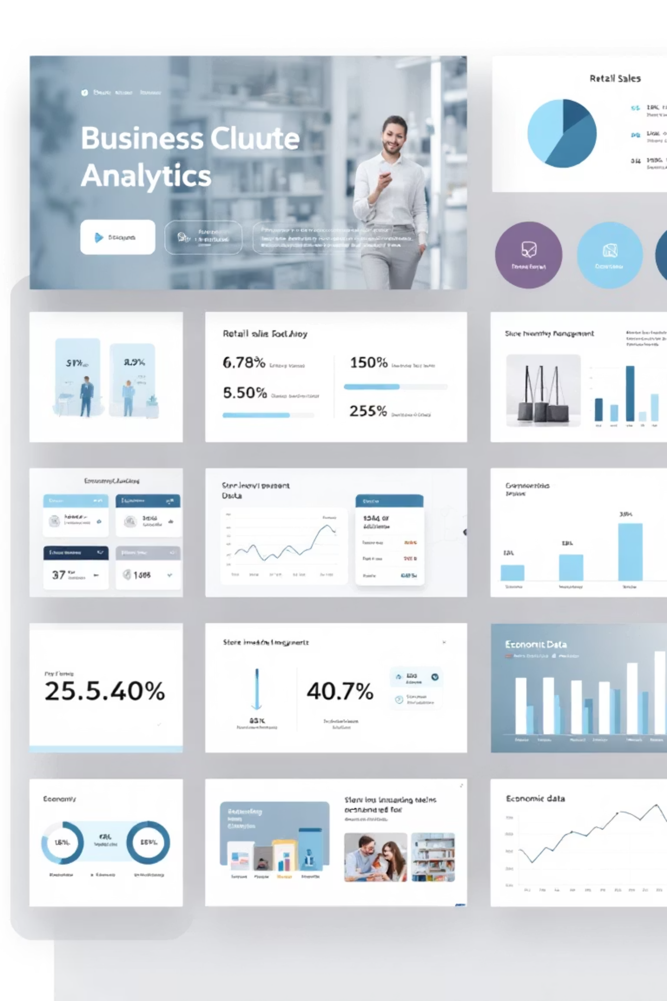

Dataset Information
Store-wise sales data
Weekly or daily sales figures
Holiday and seasonal indicators
Economic factors such as fuel price, CPI, and unemployment
This dataset represents real-world retail business scenarios.

Slide 7


Machine Learning Models
1
Linear Regression
for baseline comparison
2
Random Forest Regressor
for handling non-linear patterns
The final model is selected based on evaluation metrics.

Slide 8

Results and Evaluation
Mean Absolute Error (MAE)
Actual vs Predicted sales comparison
The selected model provides accurate and reliable sales forecasts.

Slide 9





Business Impact
Improving demand forecasting accuracy
Reducing overstock and stock-out situations
Supporting strategic planning and promotions
Enhancing overall operational efficiency

Slide 10

References
Kaggle Retail Sales Forecasting Dataset
Scikit-learn Documentation
Power BI Data Visualization Resources

Slide 11

Thank You!
This project demonstrates how machine learning can transform sales forecasting into a powerful business intelligence tool.

